Slide 1

Performance comparison of two RNA sequencing techniques:
DriverMap vs RNAseq
Leeza Sergeeva and Lucila Rondissone
Data Analytics Bootcamp

Slide 2
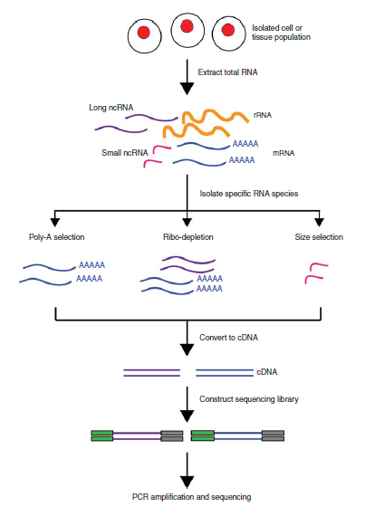
INTRO: What is RNA sequencing?
The output of the sequencing (after some manipulation) is number of reads per gene. This can be further normalized as TPM (transcripts per million kilobase) and better visualized by taking log2 of TPM.

Slide 3
Hypothesis and questions
Goal: To find if DriverMap (DM) sequencing technique performance is comparable to RNAseq performance.
Hypothesis: both techniques are significantly different and DM is better.
1- How does DM global efficiency compare to the RNAseq?
2- Is there a noticeable difference in the detection ability of variable expression genes by DM compared to RNAseq?
3- Does DM pick up the highly expression genes in comparable quantities?
4- Did addition of BSA and glycerol reduce non-specific background in multiplex PCR? Did it have any impact on the ability to detect high expression genes?

Slide 4
Summary of results
1- The two techniques seem to have similar coverage of genes, with both having a high density of low expressing genes or even genes that aren't picked up at all.
2- Both techniques have a group of very dispersed highly expressing genes. DM seems better at picking up low and high expressing genes, and RNAseq has fewer genes with no reads.
3- DM picks up on average more high expression genes, but only in 5 of 10 libraries it gets more reads per gene .
4- Addition of BSA while prepping samples didn’t show dramatic increase in number of reads for all samples. Only three samples showed significant statistical difference with p-values < 0.05

Slide 5
Data acquisition
Cvs files with results from the 2 techniques were provided by employer.
Basic normalization of the data was performed from the RNA-seq experiment
Identity of genes was provided with the number of read
Data normalized to TPM (transcripts per million)
Tried to pull data for the base expression of the gene using API

Slide 6
Data cleaning and formatting
We worked with 2 dataframes, one per each technique. Each Data Frame had the TPM values for 19k genes and 10 libraries.
We made 2 new dataframes with log2 of each value in the original dataframes.

Slide 7
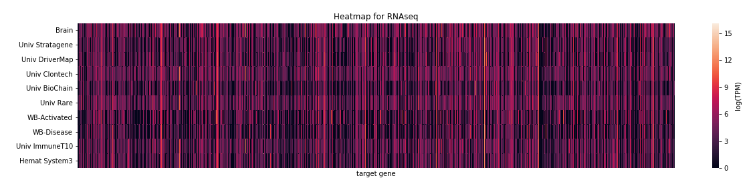
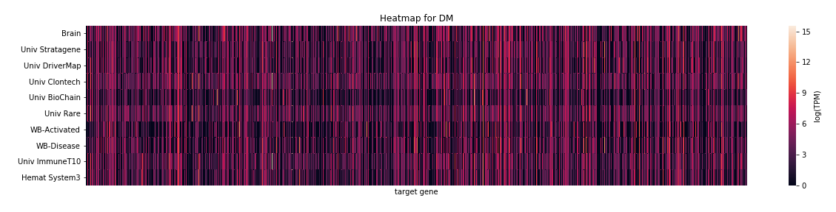
First exploration: heatmaps

Slide 8
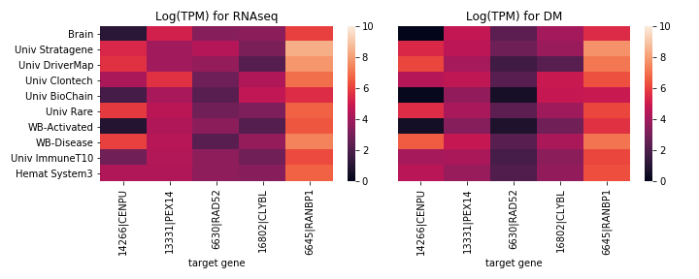
Let’s zoom in!

Slide 9
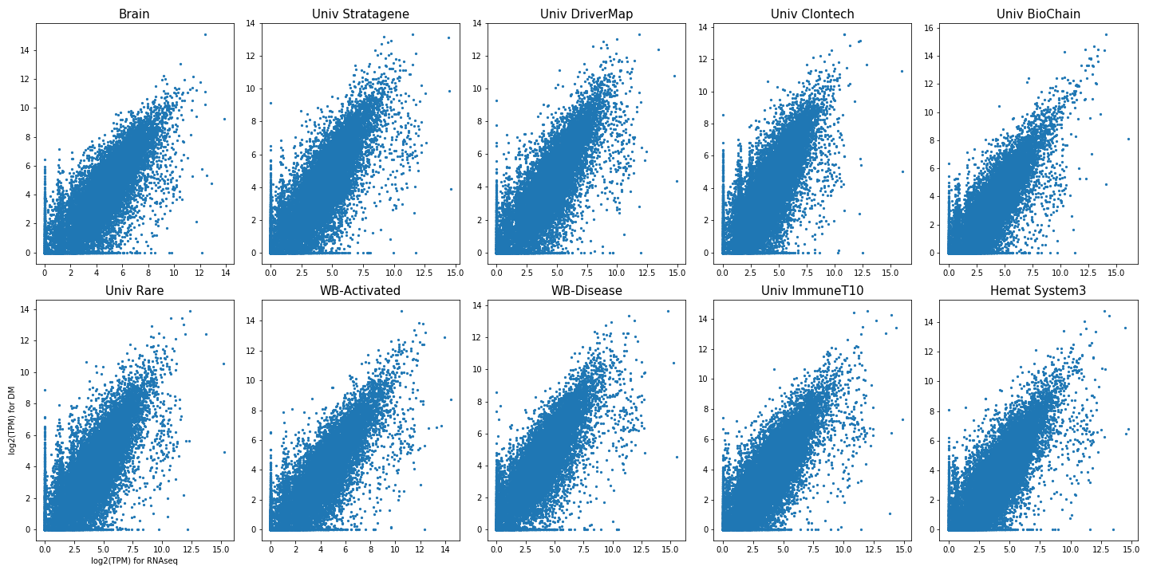
How do the 2 techniques compare on global results?

Slide 10
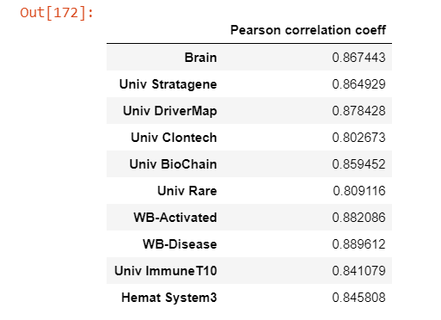
How do the 2 techniques compare on global results?
Pearson correlation test:

Slide 11
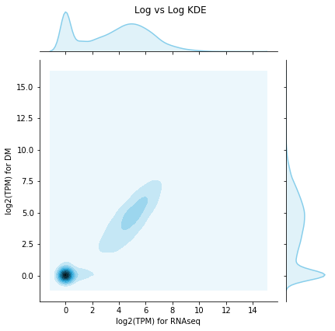
What’s the density of points like?

Slide 12
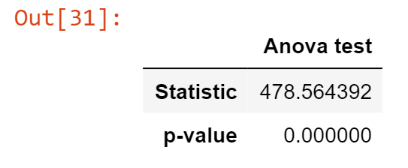
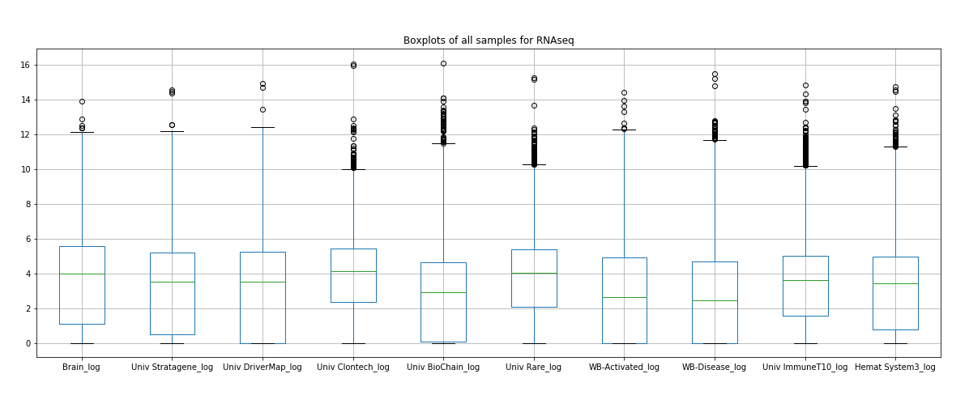
Are all samples independent?
How do the means compare? ANOVA test

Slide 13
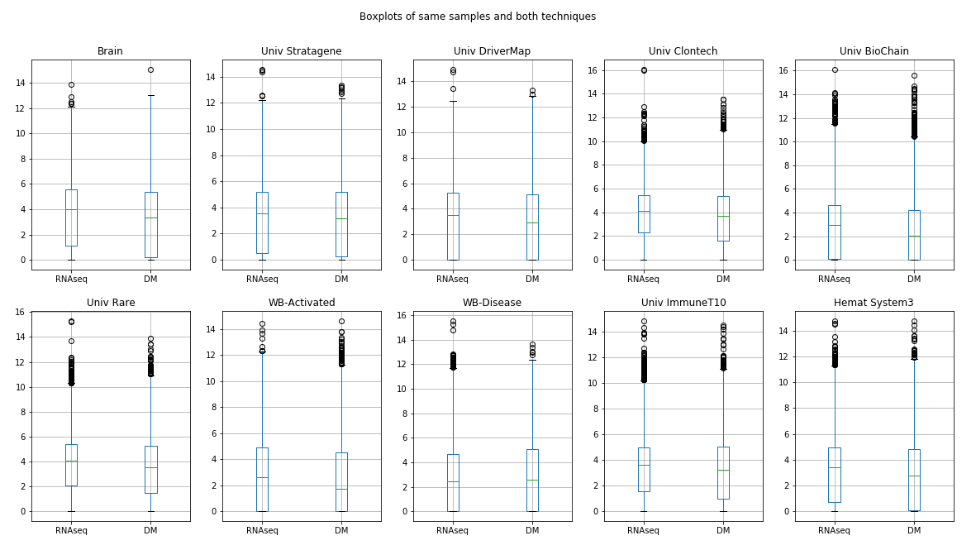
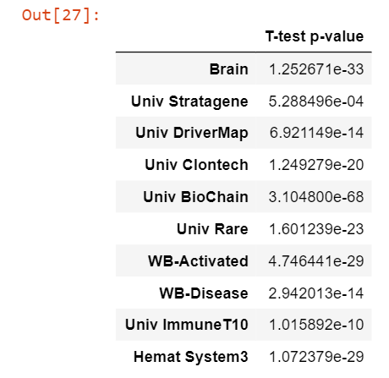
Are the techniques equivalent?
T-test per pair of samples

Slide 14
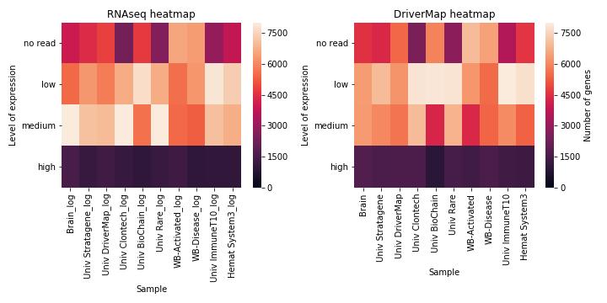
Can both techniques pick up similar levels of differentially expressed genes?
We binned the data into four groups: no read, low, medium and high expression.

Slide 15
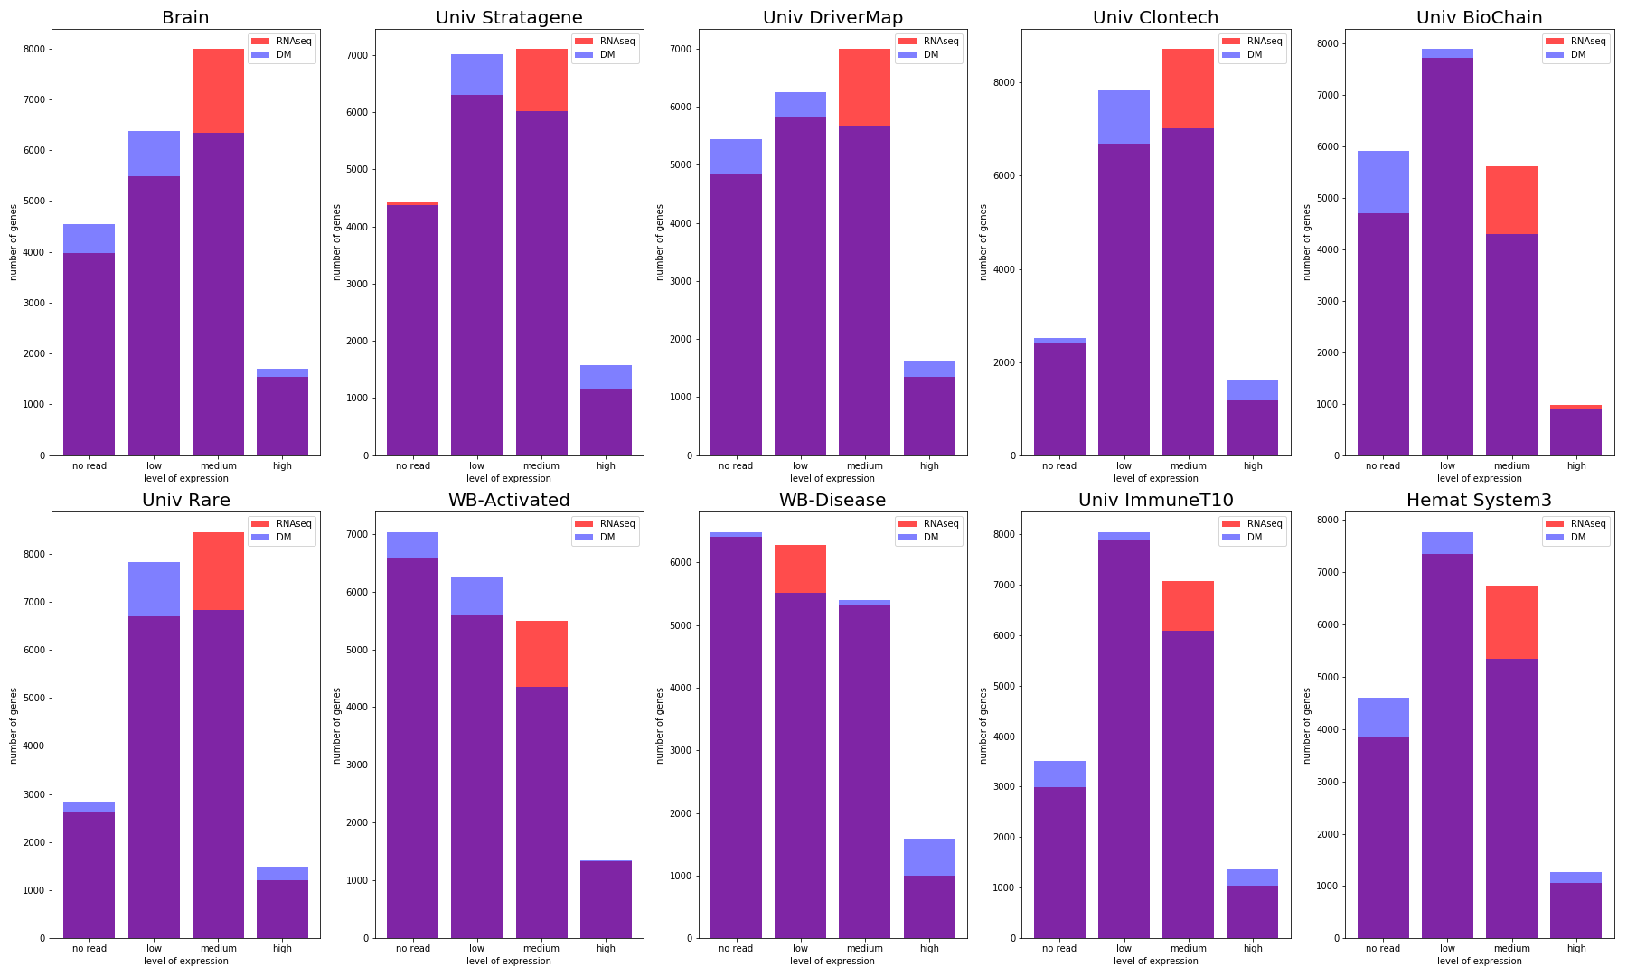

Slide 16
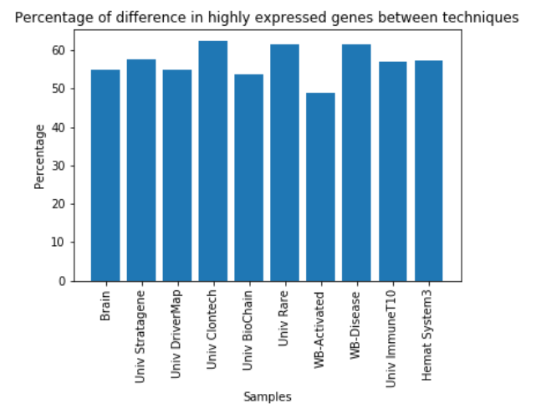
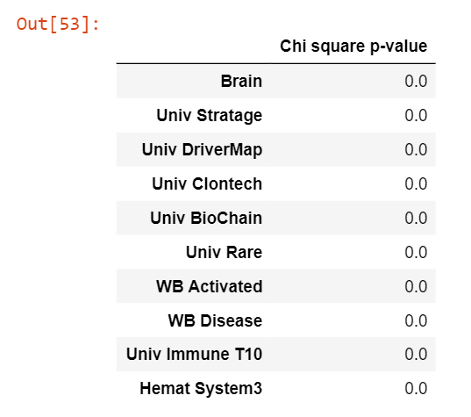
Do both techniques pick up the same high expression genes?
Chi square test to compare the differences in TPMs between techniques

Slide 17
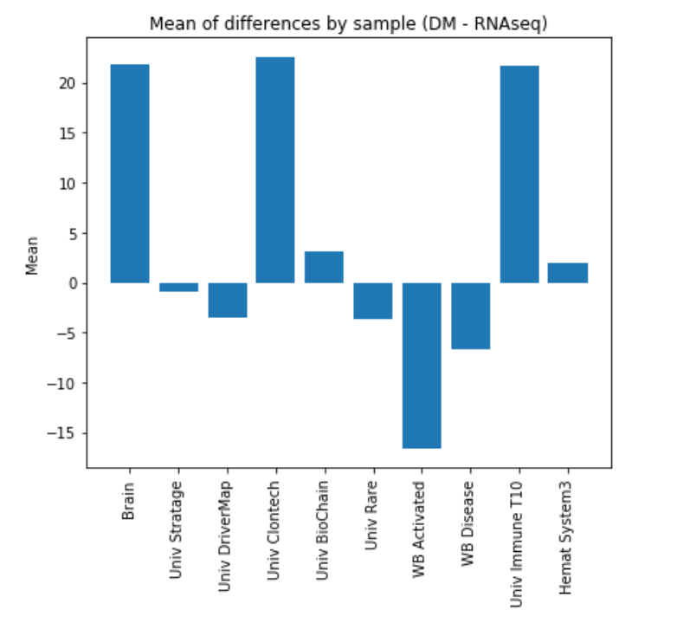
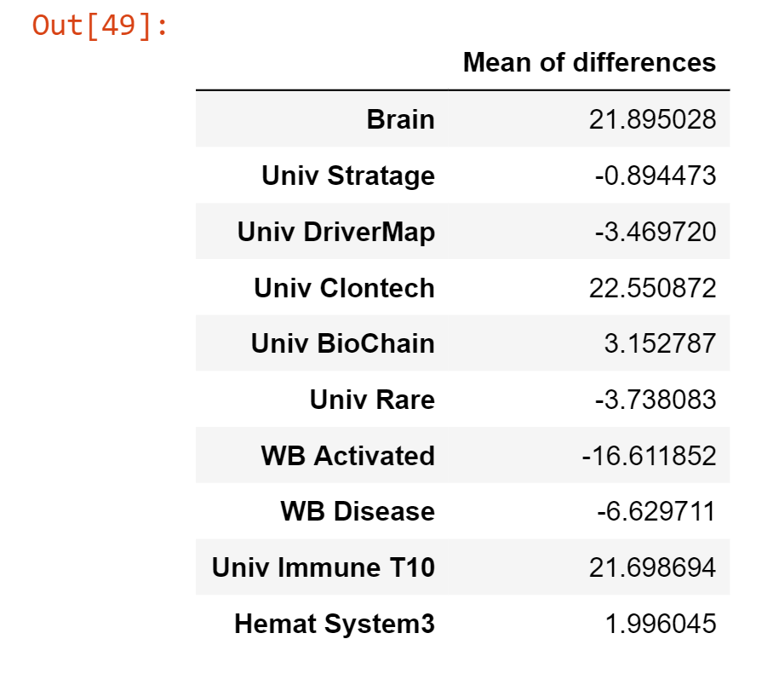
Which technique has more TPMs per gene?
We took the mean of the differences between genes’ TPM for both techniques

Slide 18
Conclusions:
1- Both techniques follow the same pattern of high count of no read genes and low expression genes. Both techniques pick up few high expressing genes. Their pattern shows correlation not high enough to say they are replicates.
2- This is further confirmed by seeing that both techniques show significant difference in their mean of TPM. We can say they are different (not working as replicates).
3- DM looks better at picking up high expressing genes, but it does it at less counts per gene than RNAseq in 5 of the 10 libraries. It would depend on the aim of the study for what technique to choose.
4- The difference in high expressing genes picked up is always more than 50 percent, and the difference in TPMs between both techniques is significant.

Slide 19
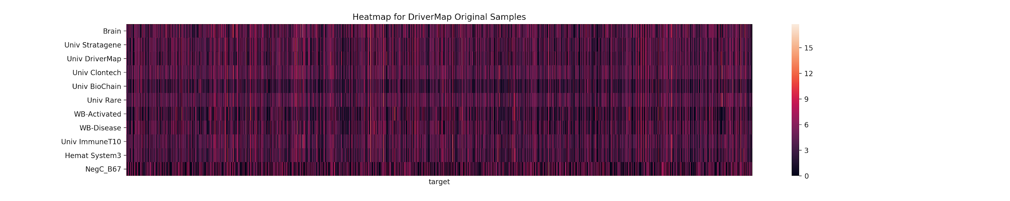
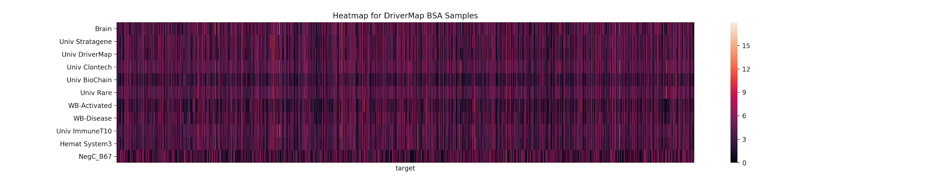
DriverMap Sample Comparison

Slide 20
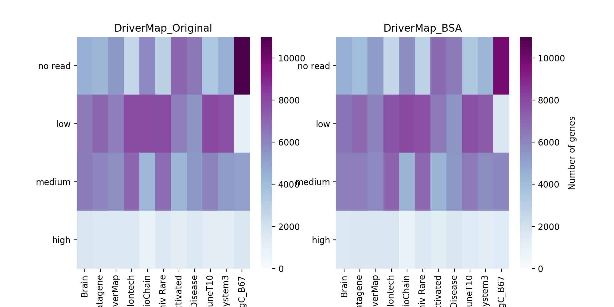
Heat Map sample comparison

Slide 21
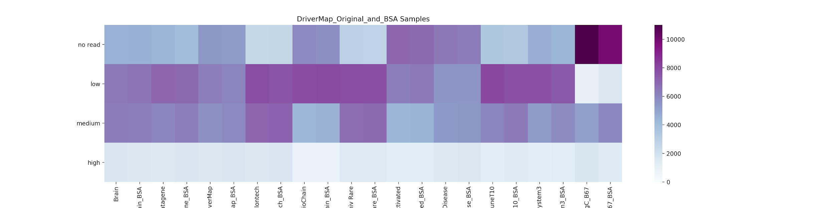
Heat Map with side by side comparison

Slide 22
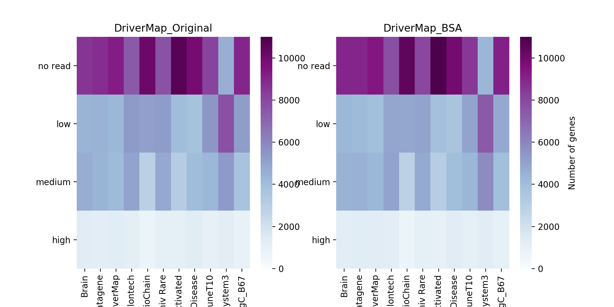
Heat Map sample comparison (NC)

Slide 23
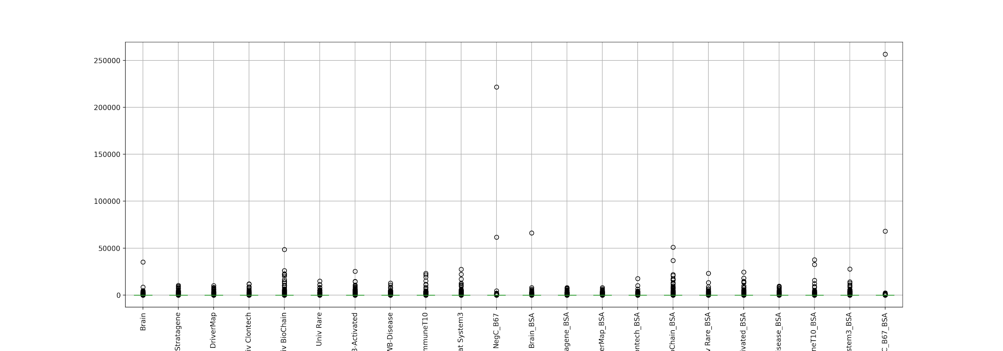
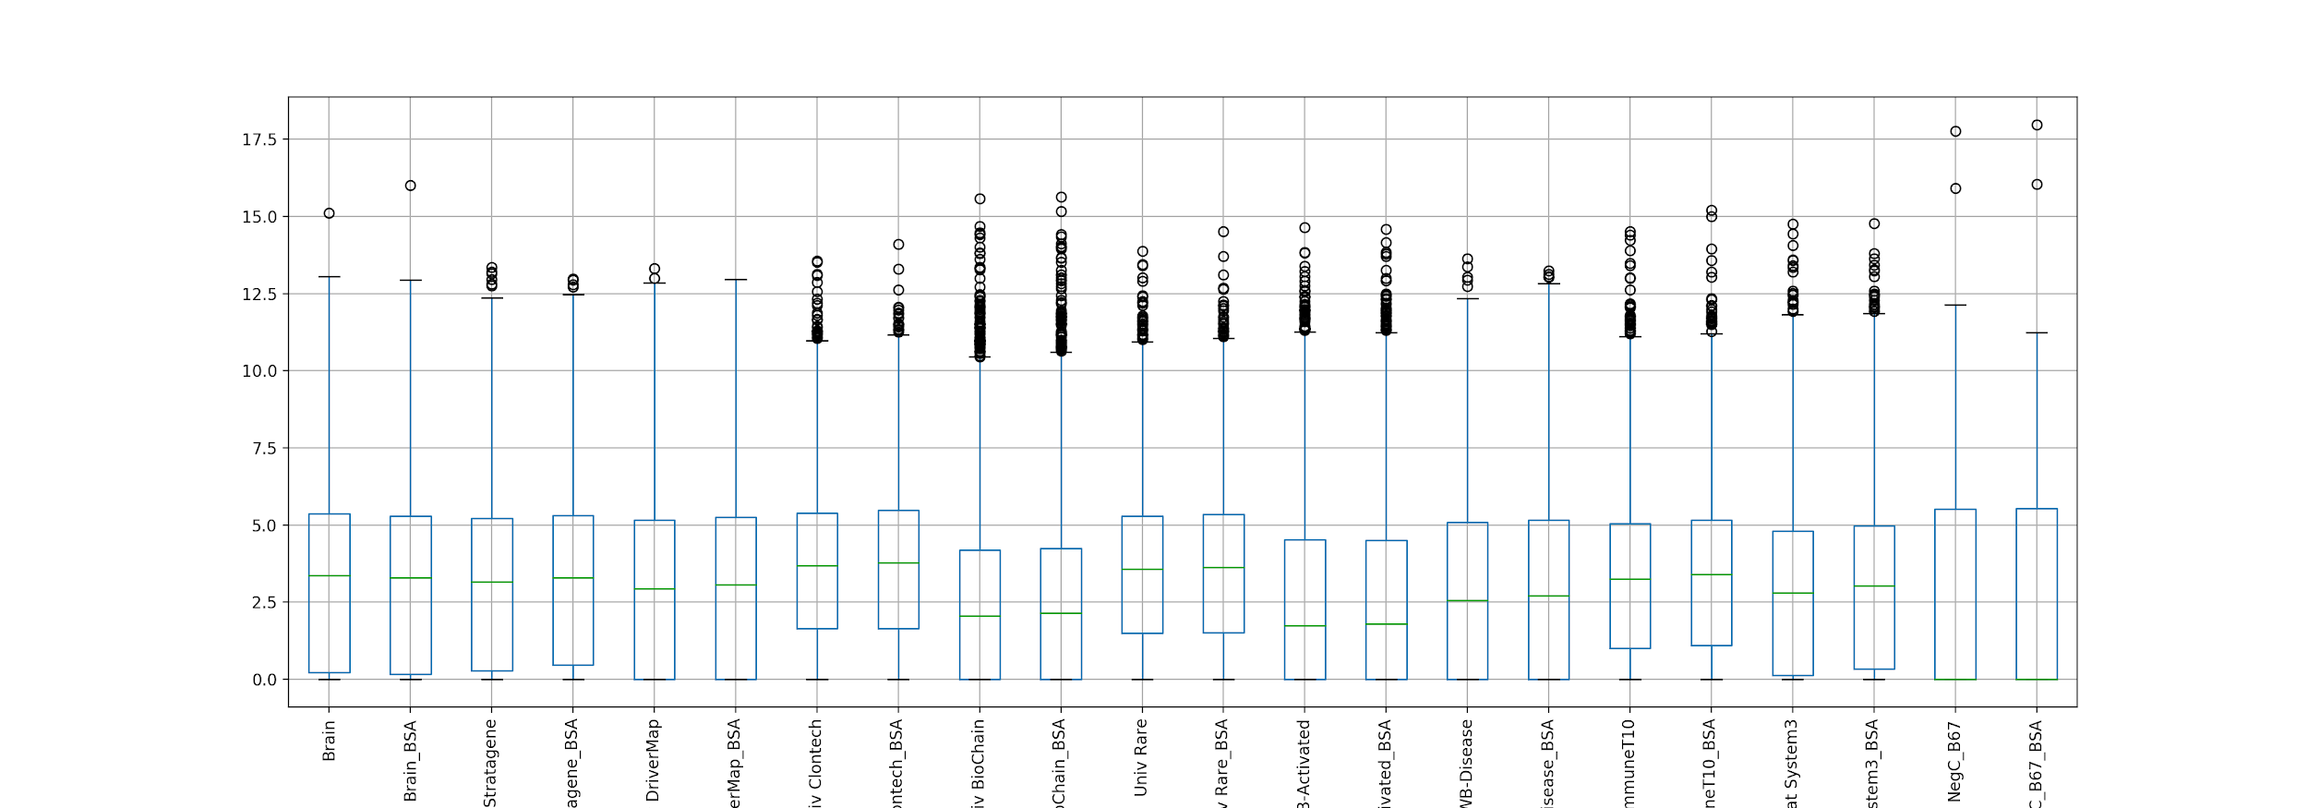
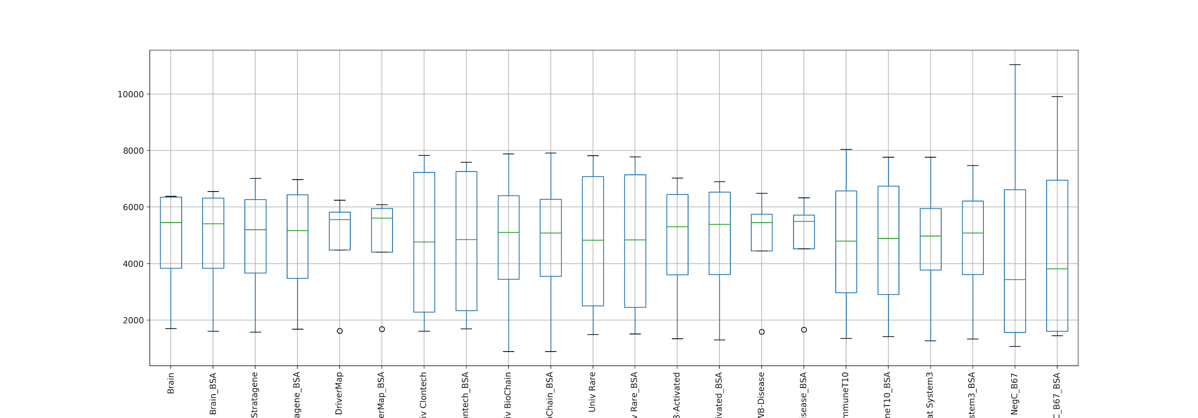
Normalizing Data
Looking at outlier distributions
TPM
log2(TPM)
After sorting gene expressions by bins we got nice and uniform data with minimal outliers
Bins

Slide 24
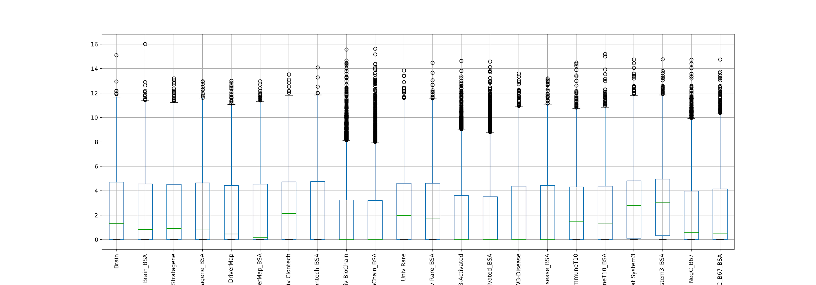
Normalizing Data (NC)
Looking at outlier distributions
TPM
log2(TPM)
After sorting gene expressions by bins we got nice and uniform data with minimal outliers
Bins

Slide 25
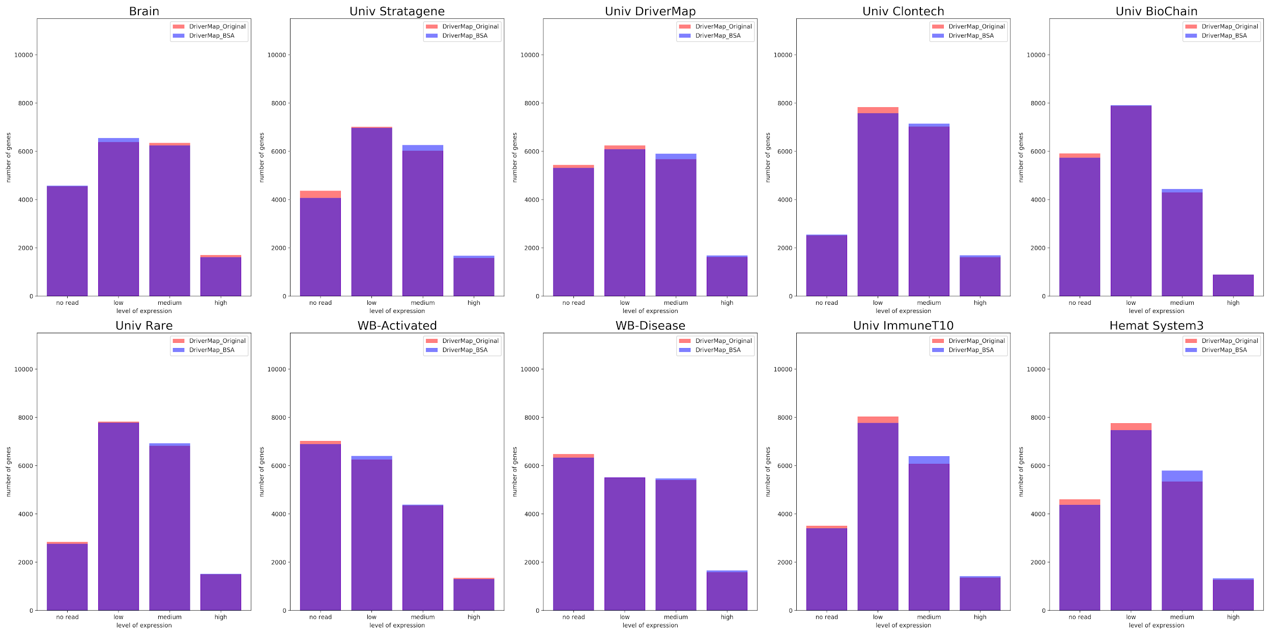
Number of genes per bin for samples

Slide 26
Number of genes per bin for samples (NC)

Slide 27
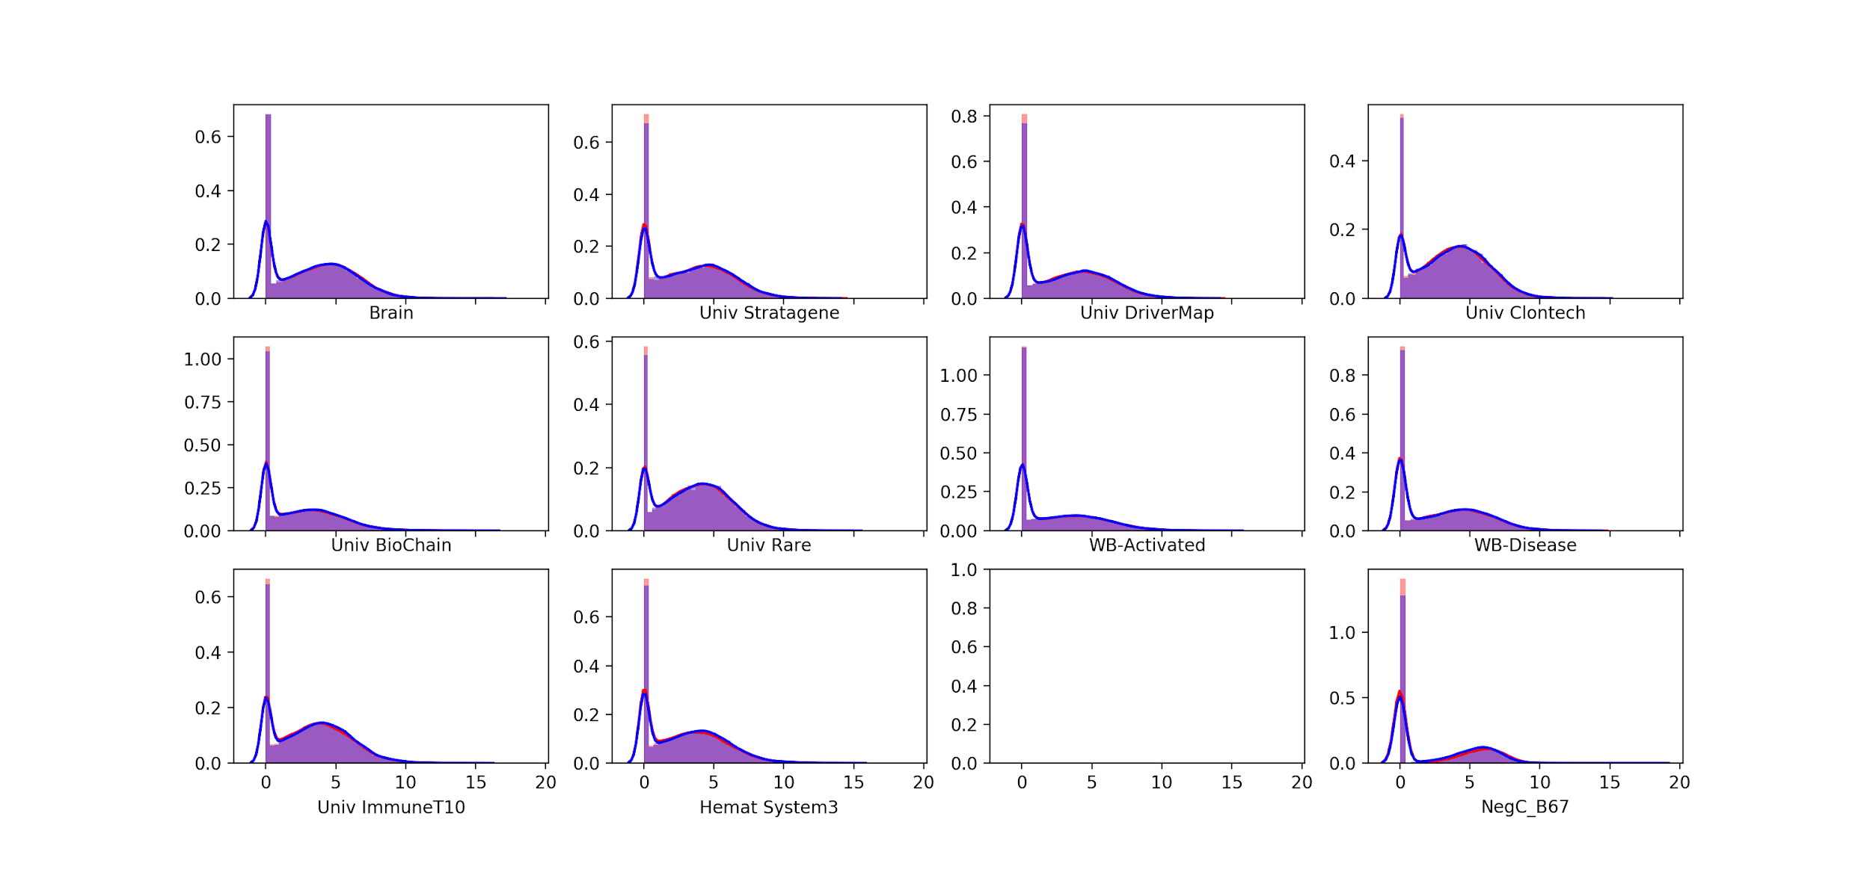
Read distribution

Slide 28
Read distribution (NC)

Slide 29
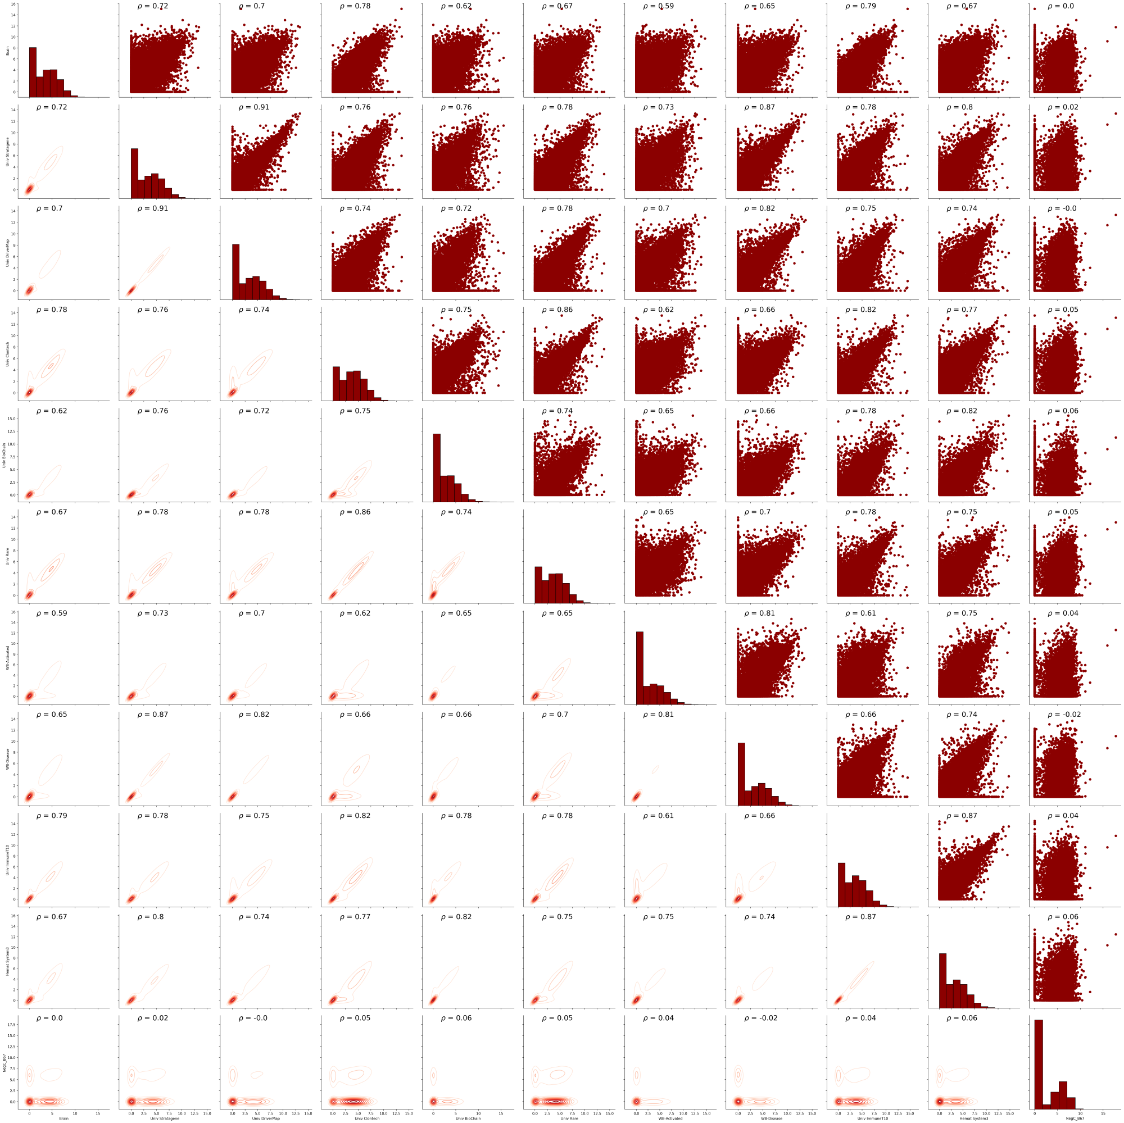
Original Samples Logs
BSA Samples Logs

Slide 30
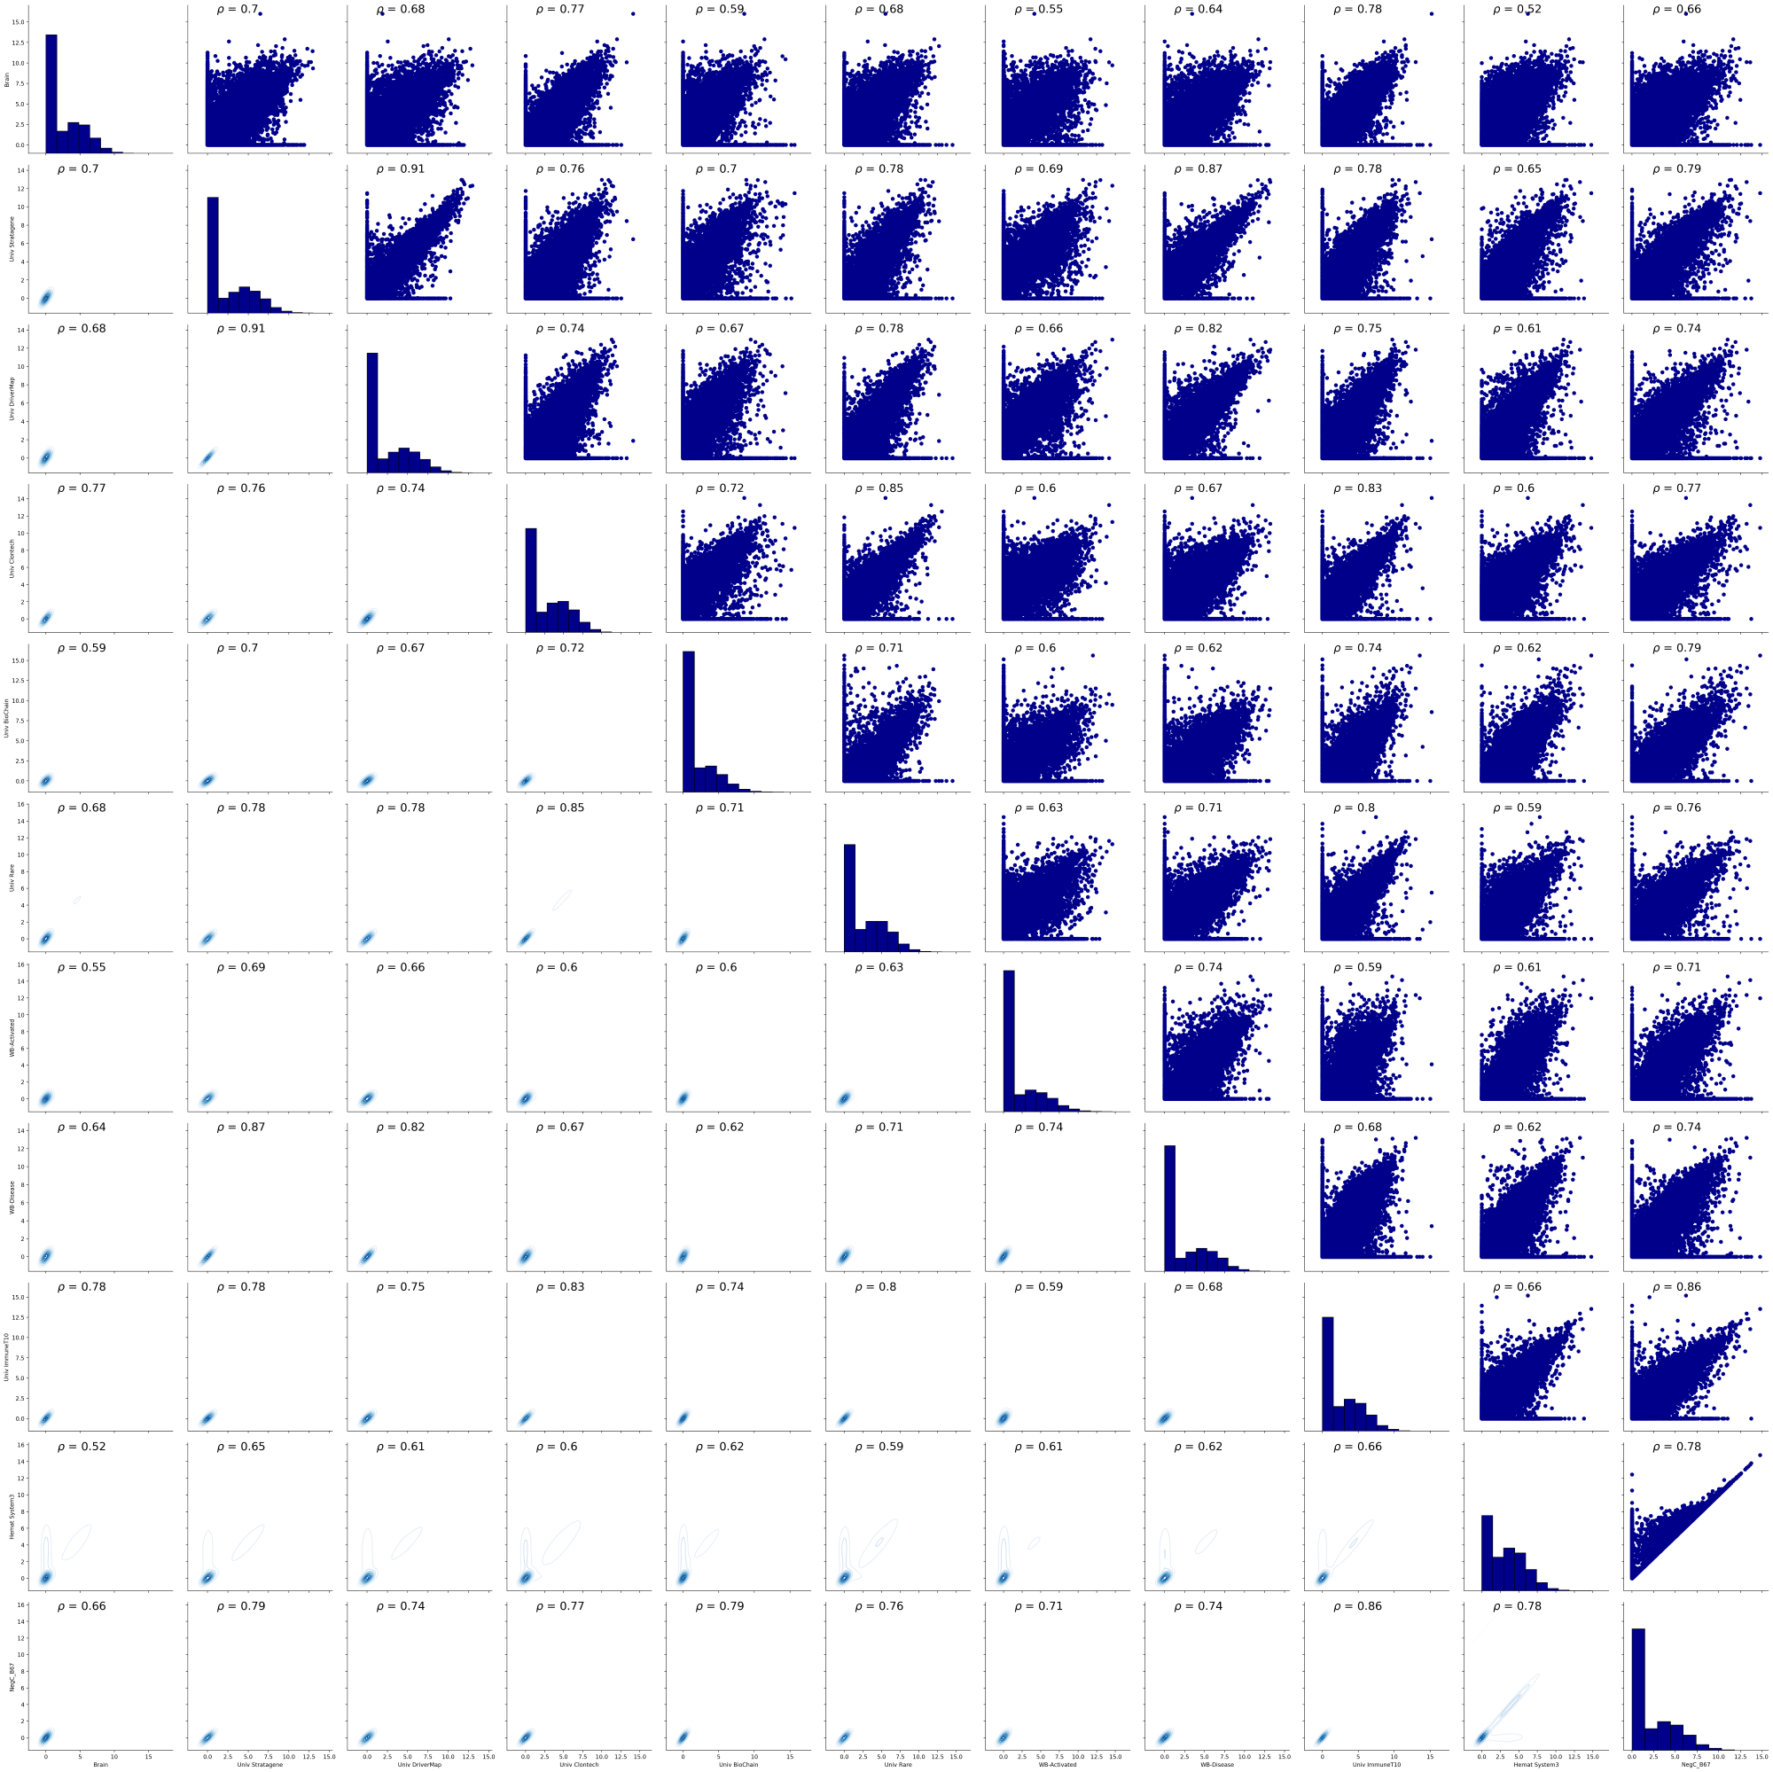
Original Samples Logs
(NC)
BSA Samples Logs

Slide 31
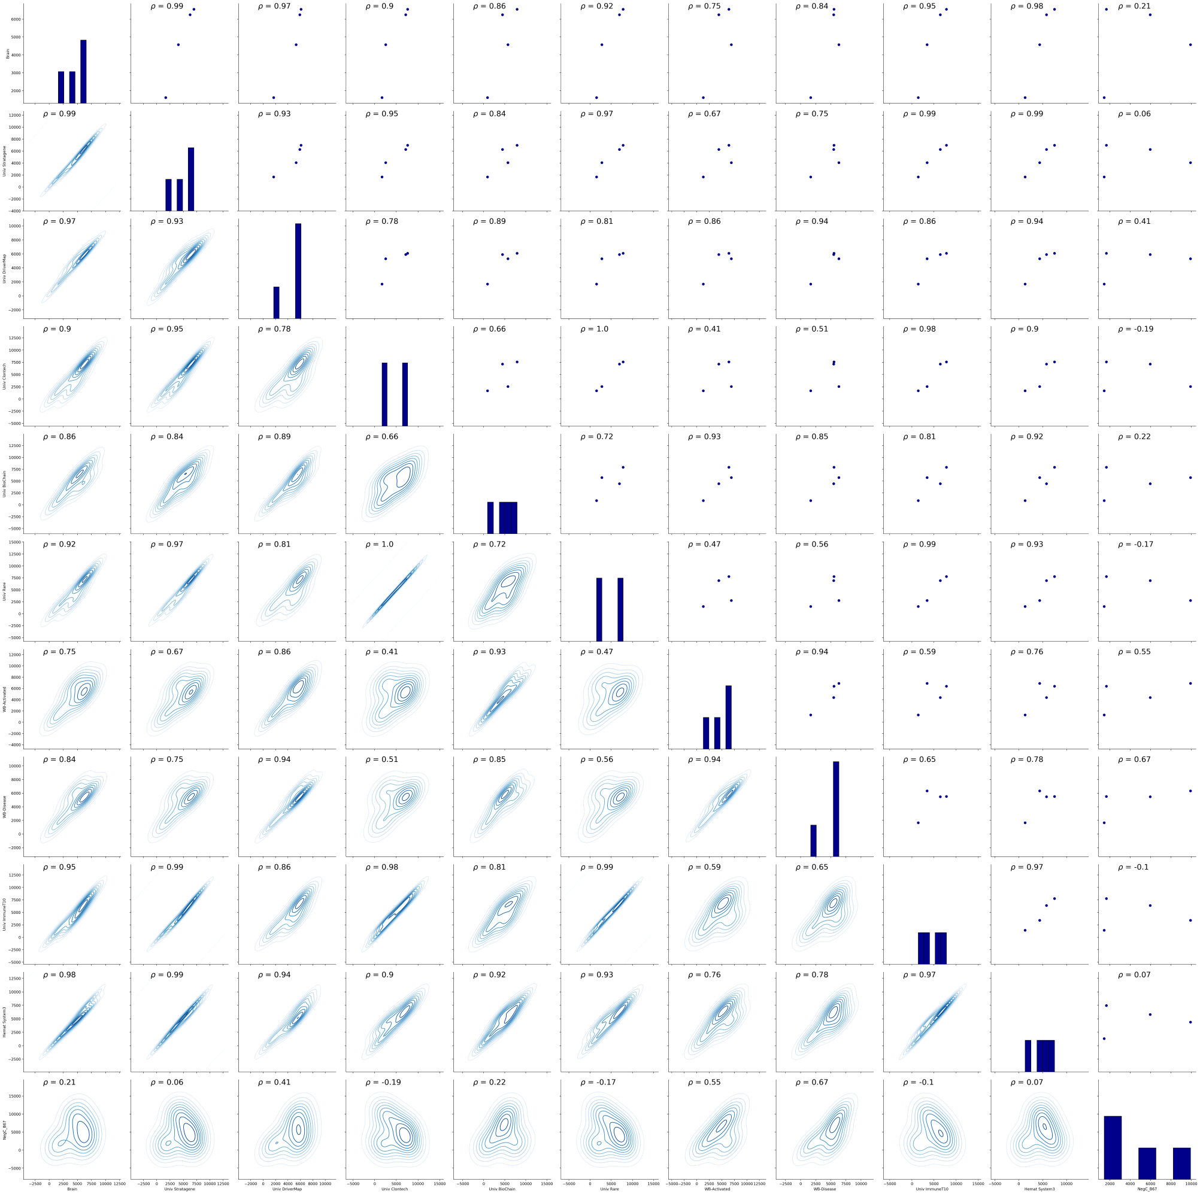
Original Samples Bins
BSA Samples Bins

Slide 32
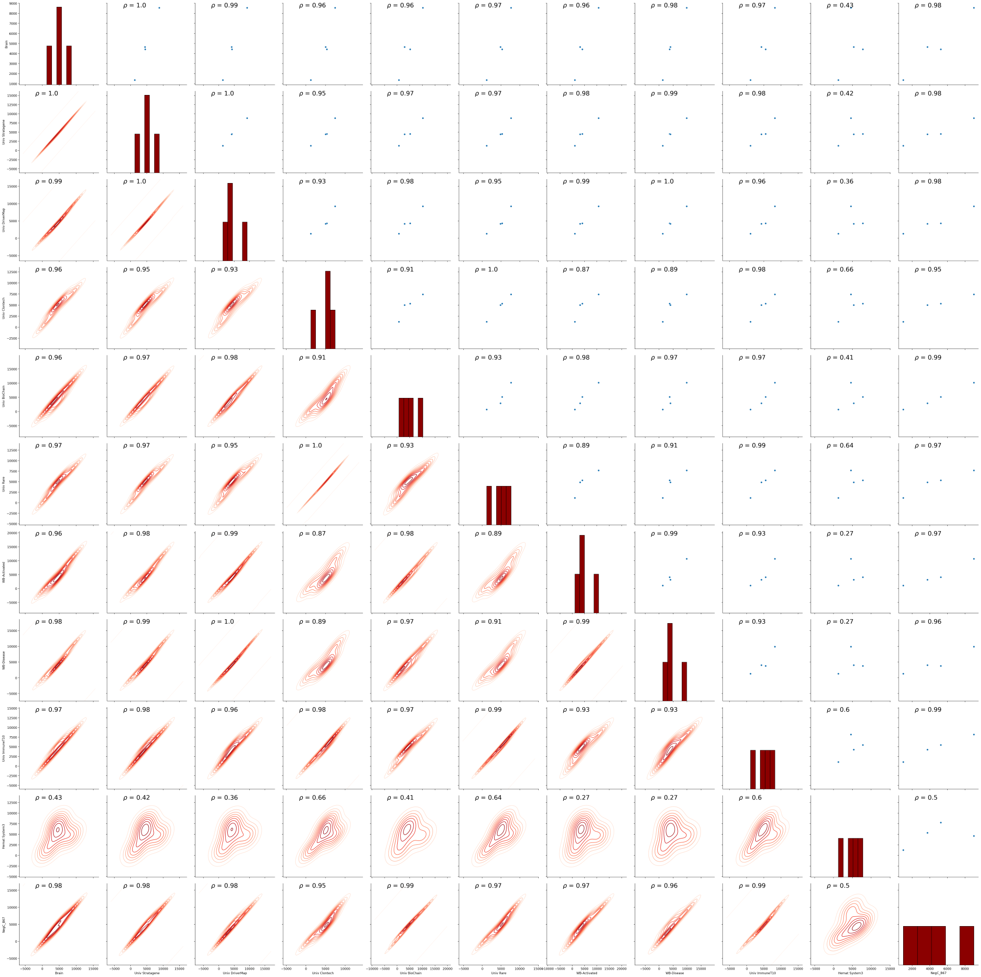
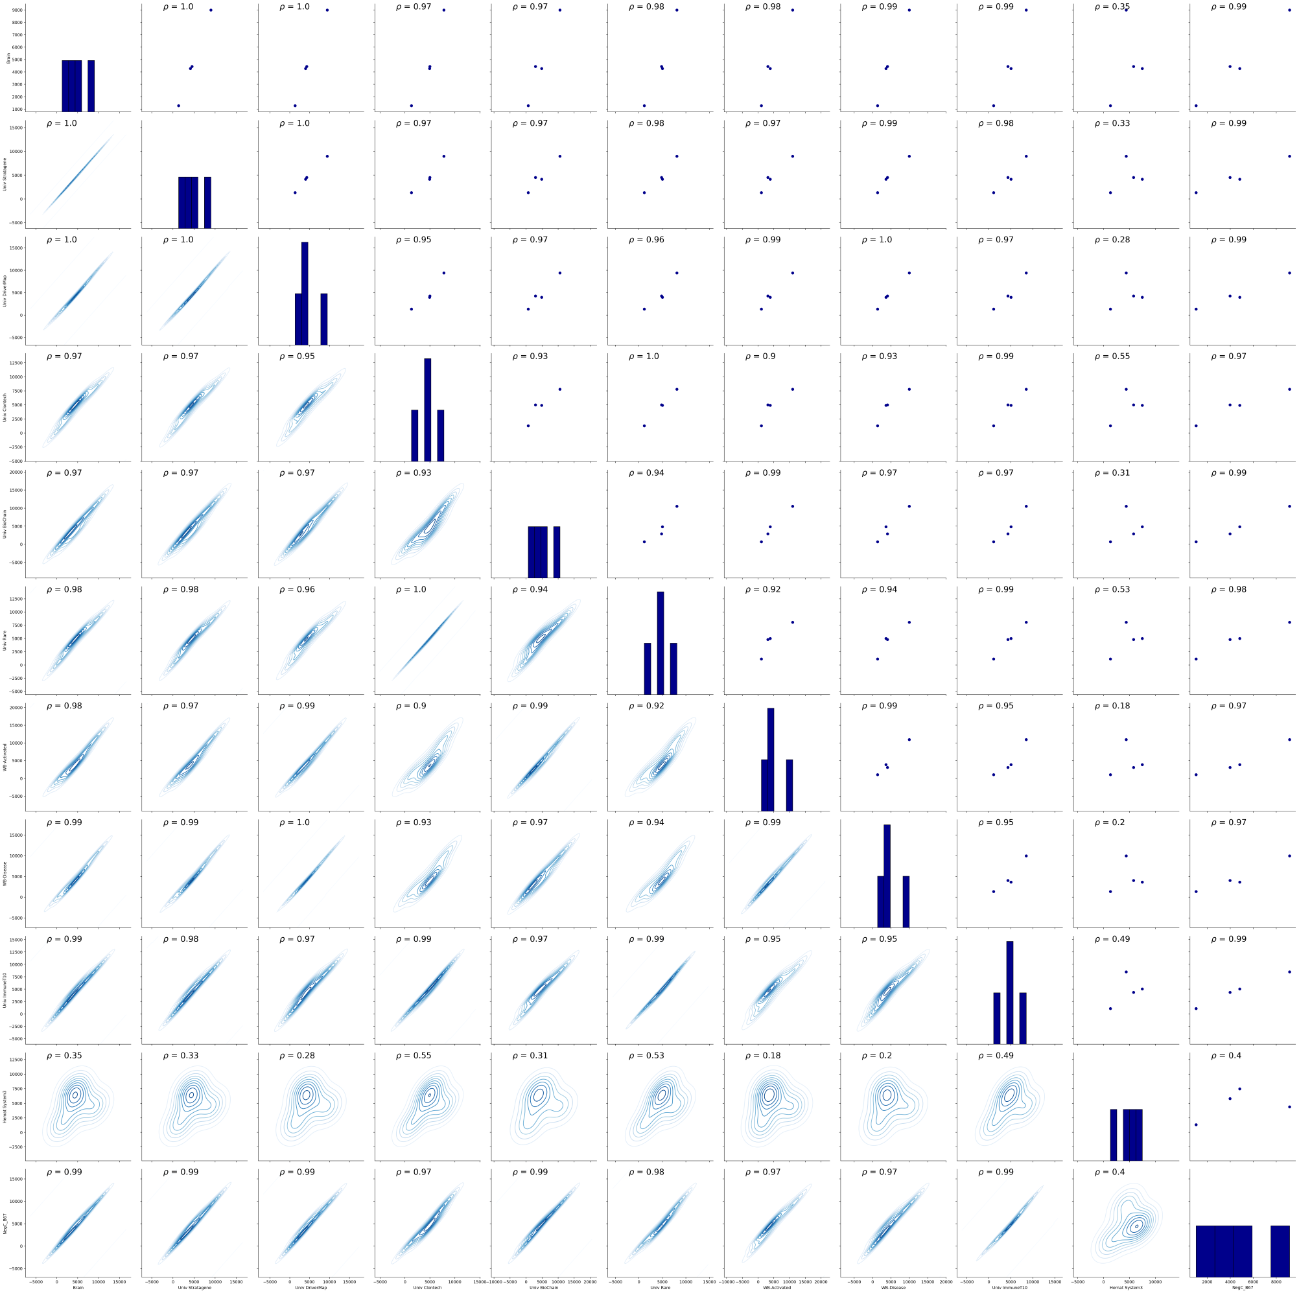
Original Samples Bins
(NC)
BSA Samples Bins

Slide 33
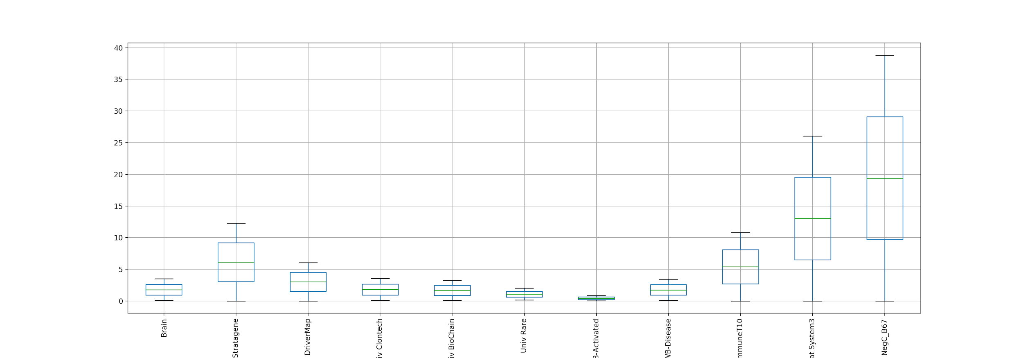
ANOVA test results

Slide 34
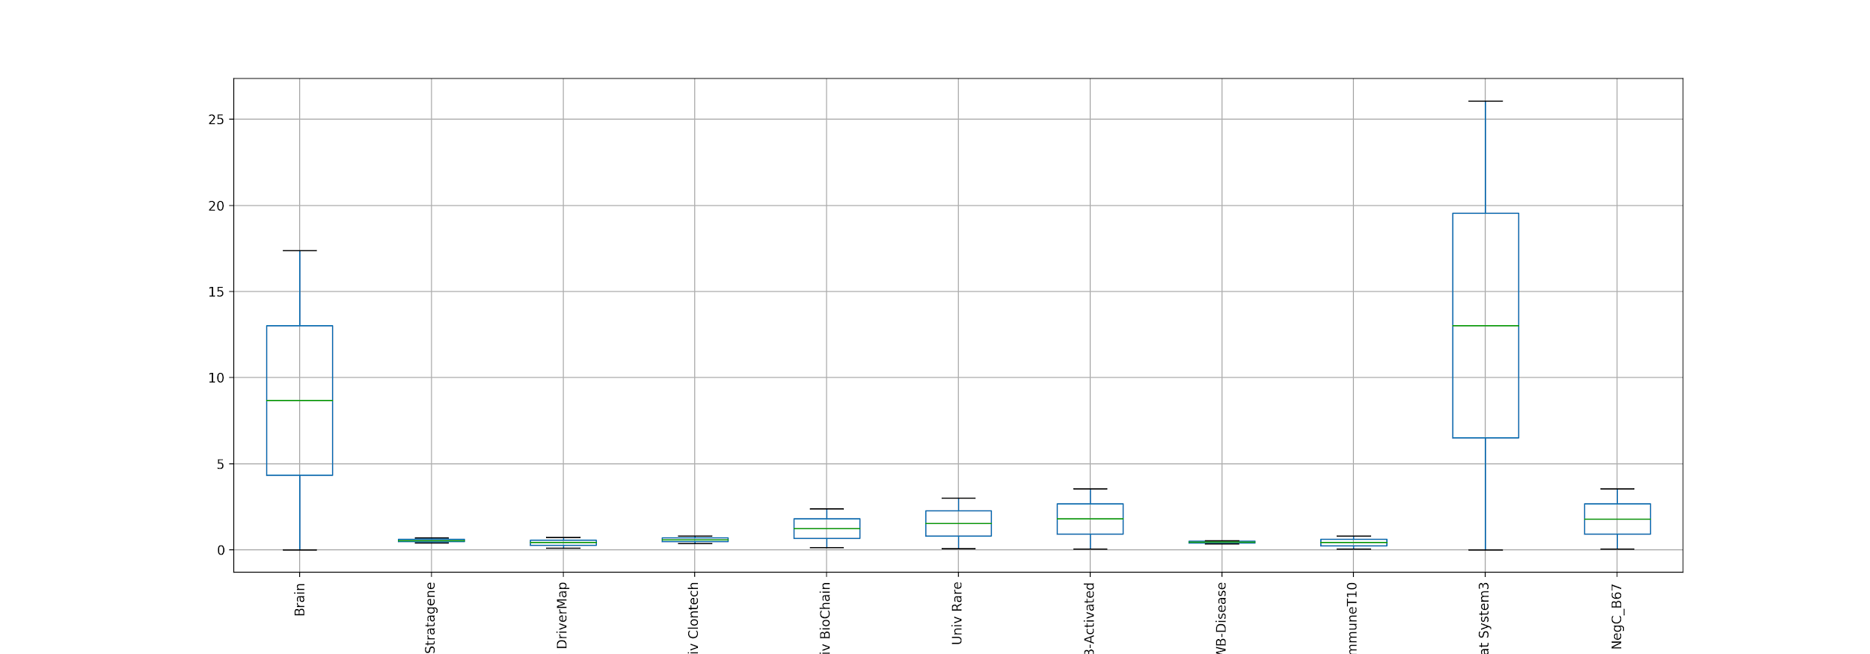
ANOVA test results (NC)

Slide 35
REST API fun!
Used https://rest.ensembl.org/
Little demo on how we wanted to scrape for extra data for base gene expression in humans by tissue types.
LIMITATIONS:
When you have 19k genes with 44 different types of tissue there is just too much data to retrieve.

